Slide 1
Autonomous AI in Spacecraft Operations
Department of Computer Science and Engineering
20CSP403A: Seminar
Name: Aditya Atreya, Bhoomika K
Reg. No: 21ETAI410029, 21ETAI410033
Dept.: AIML
Batch: 2021
Mentored By:
Mrs. Naganandini. G
Assistant Professor
Department of Computer Science and Engineering, FET,RUAS

Slide 2
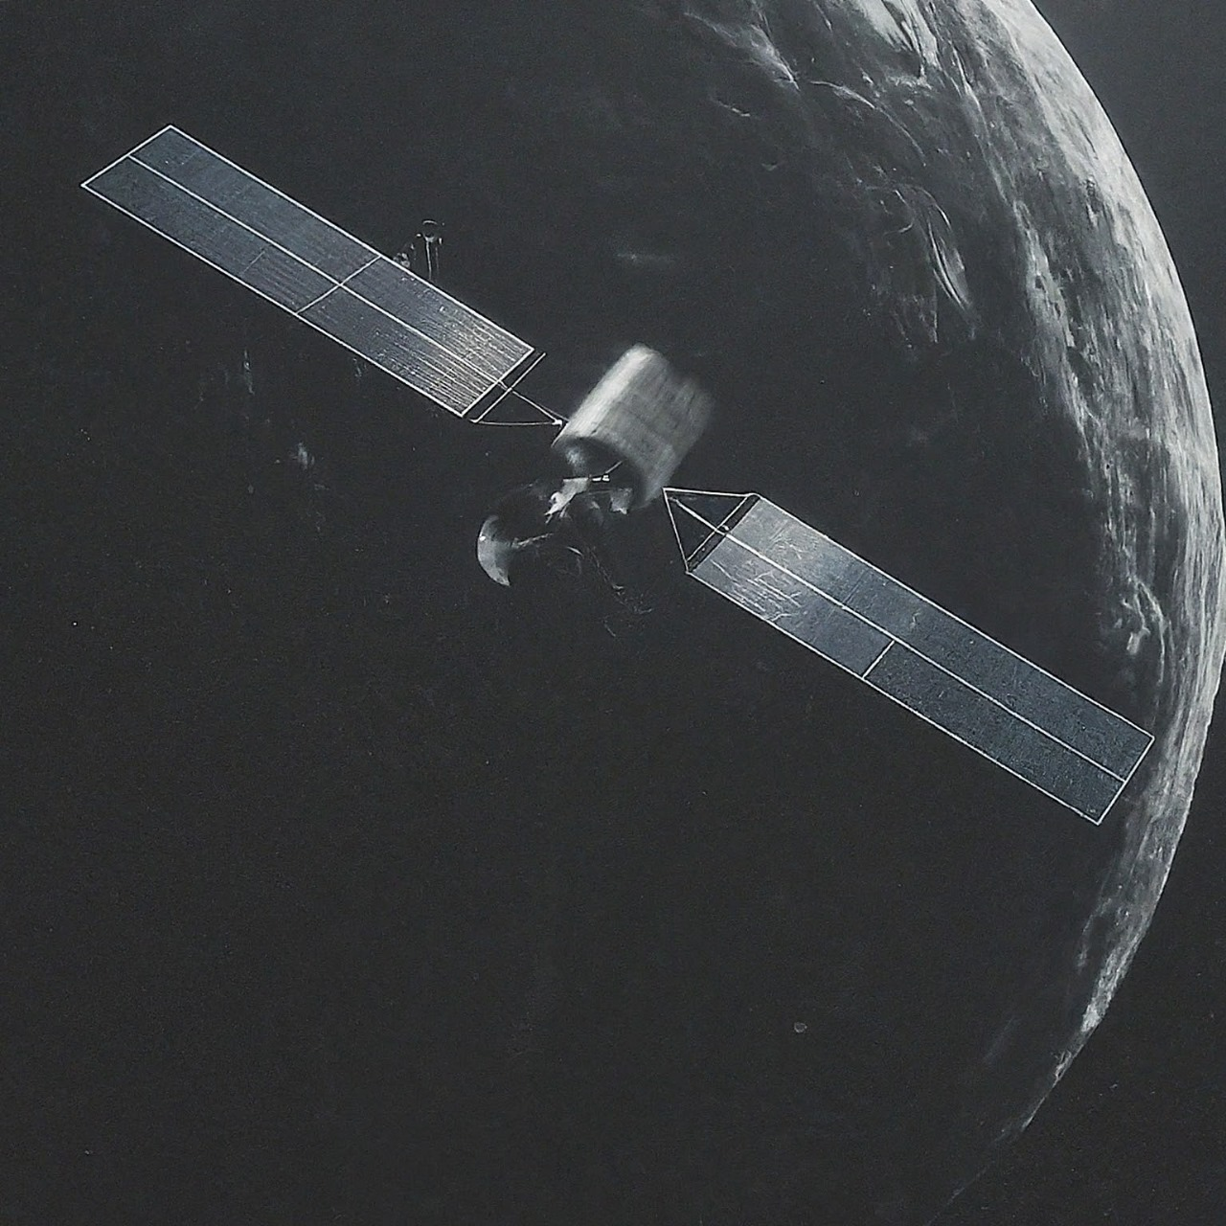
INTRODUCTION
Autonomous AI in spacecraft operations refers to the use of intelligent systems that perform tasks and make decisions independently of human control. These AI systems manage navigation, control, data analysis, and diagnostics to enhance mission efficiency and safety.
Autonomous AI is set to revolutionize space exploration, enabling more efficient, safe, and successful missions.

Slide 3
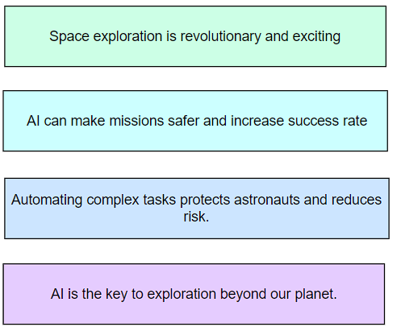
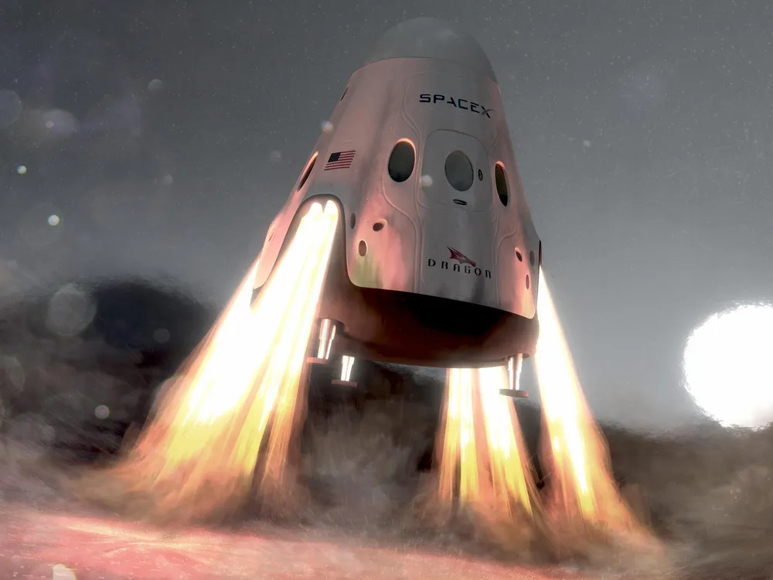
Motivation for Choosing the Topic
We chose this topic as it connects my passion for space and AI with a vision for a safer, more efficient, and inspiring future in space exploration.
PS: also I was fascinated by the movie ‘Interstrellar’

Slide 4
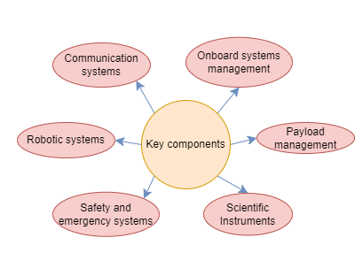
Autonomous AI in Spacecraft Operations
Theoretically, autonomous AI in spacecraft operations refers to artificial intelligence systems that operate independently to manage tasks like navigation, decision-making, and data analysis without continuous human intervention. These systems enhance mission efficiency, safety, and capability by automating critical operations in space exploration.

Slide 5
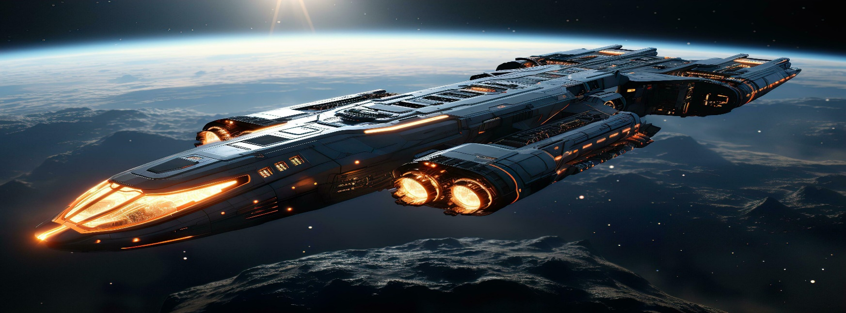
Artificial Intelligence in Space
"Artificial Intelligence (AI) plays a crucial role in pushing the boundaries of space exploration. Its applications extend beyond Earth and into the vastness of the cosmos"
Types of AI used in space missions:
Machine Learning: Algorithms learn from data to make predictions, recognize patterns, and optimize performance.
Neural Networks: Systems modeled after the human brain process complex data inputs and make decisions based on learned patterns.
Reinforcement Learning: AI agents learn through trial and error, receiving feedback from their environment to improve decision-making over time.

Slide 6
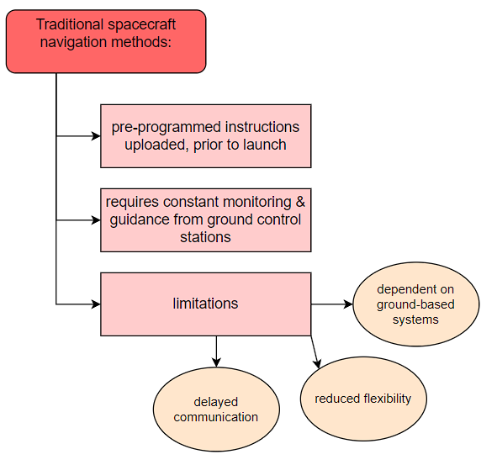
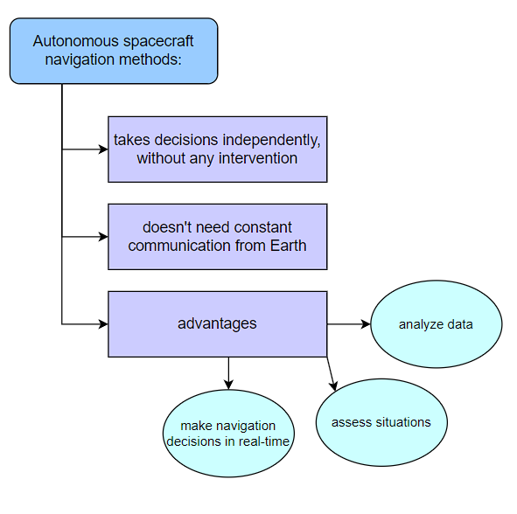
Autonomous Navigation and Guidance Systems

Slide 7
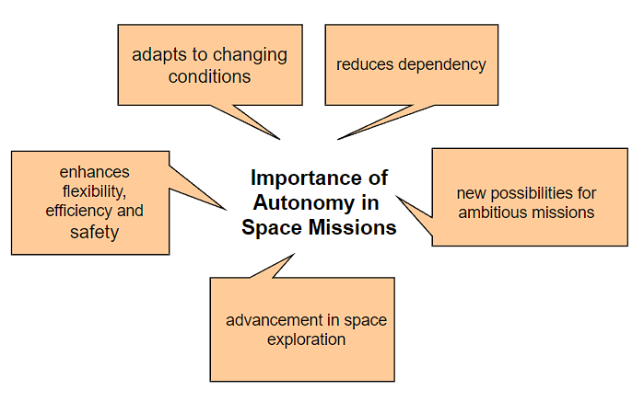
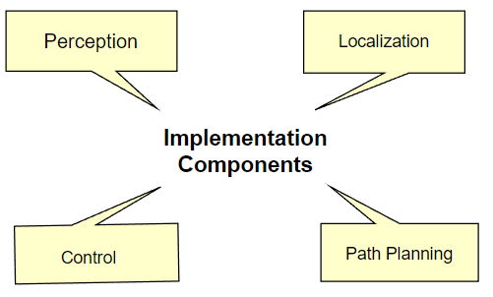
Fig.(a): importance of autonomy in space missions
Fig.(b): implementation components in space missions

Slide 8
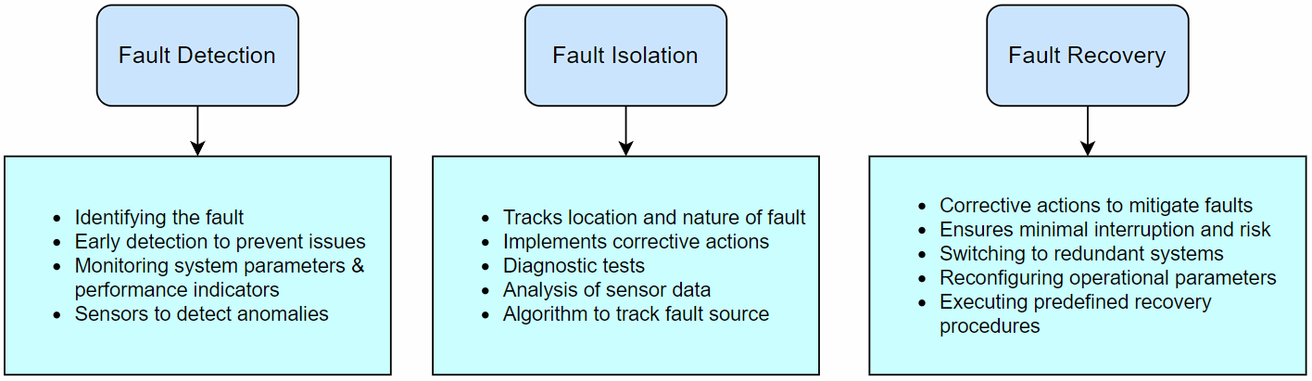
Fault Detection, Isolation, and Recovery (FDIR)
FDIR is a critical aspect of spacecraft operations, especially for autonomous systems.

Slide 9
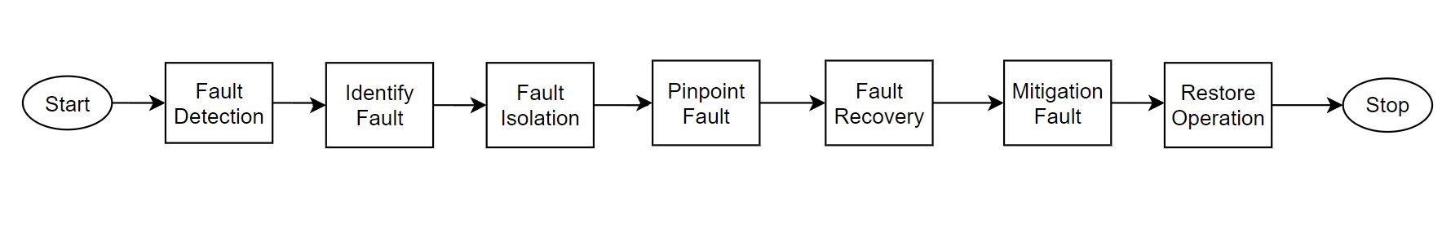
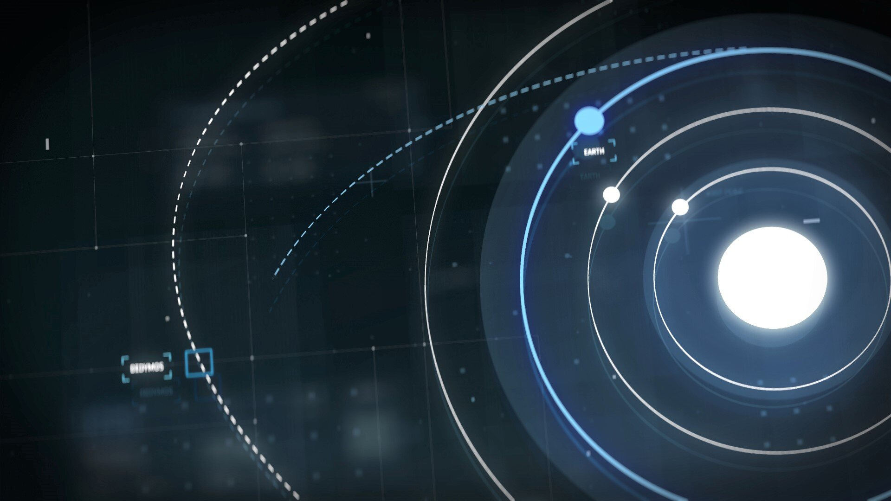
Flowchart for working of FDIR:

Slide 10
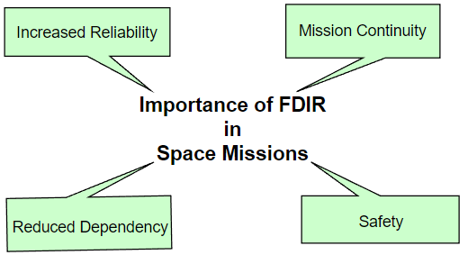
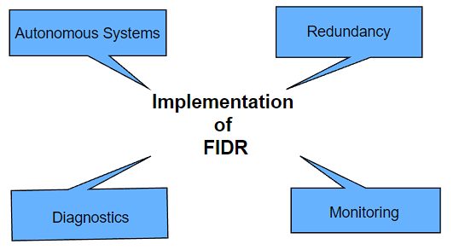
Fig.(a): importance of FIDR in space missions
Fig.(b): implementation of FIDR

Slide 11
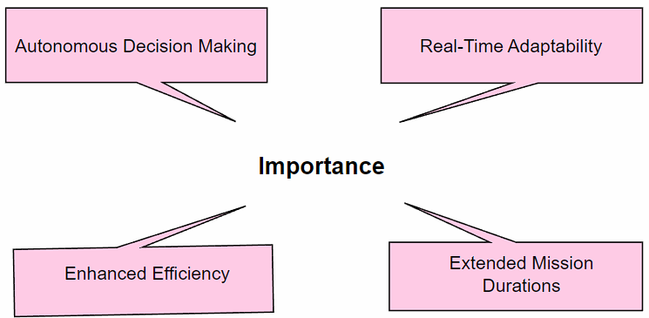
Onboard AI for Mission Planning
Onboard AI for Mission Planning is an integral part of modern space missions, leveraging advanced artificial intelligence to enhance the efficiency, adaptability, and success of missions.
Fig.: importance of onboard AI in mission planning

Slide 12
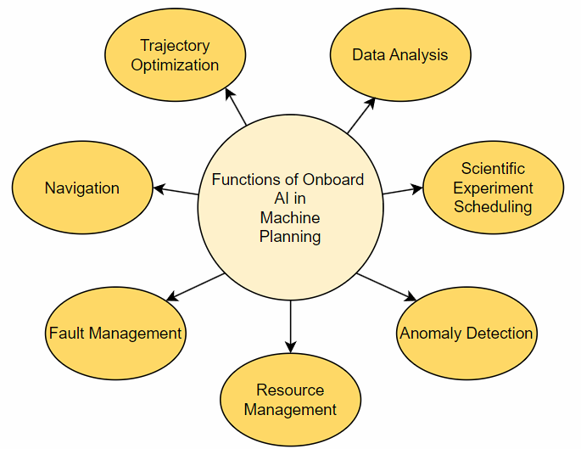
Fig.: functions of onboard AI in mission planning

Slide 13
Design
The above graph shows the increase in investment in AI for space exploration over the years| Source : CB Insight

Slide 14
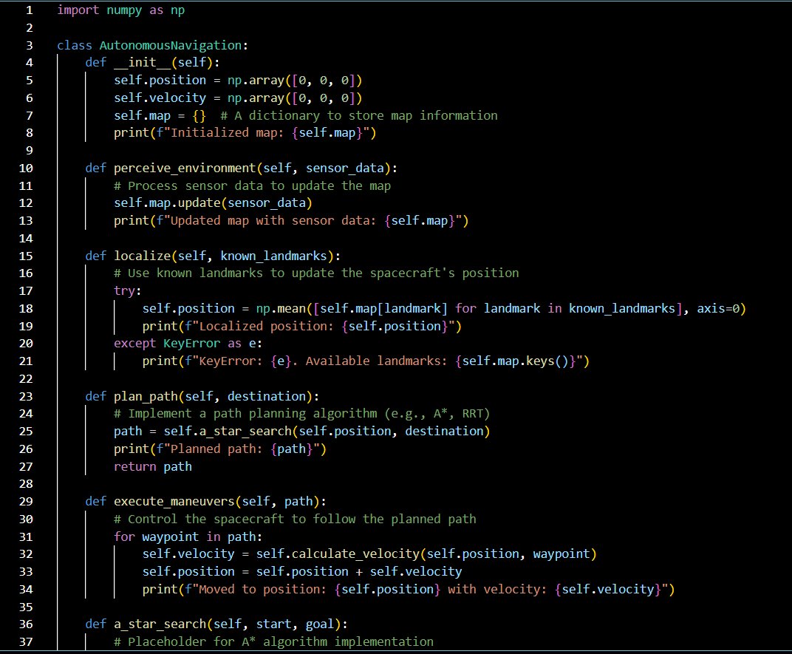
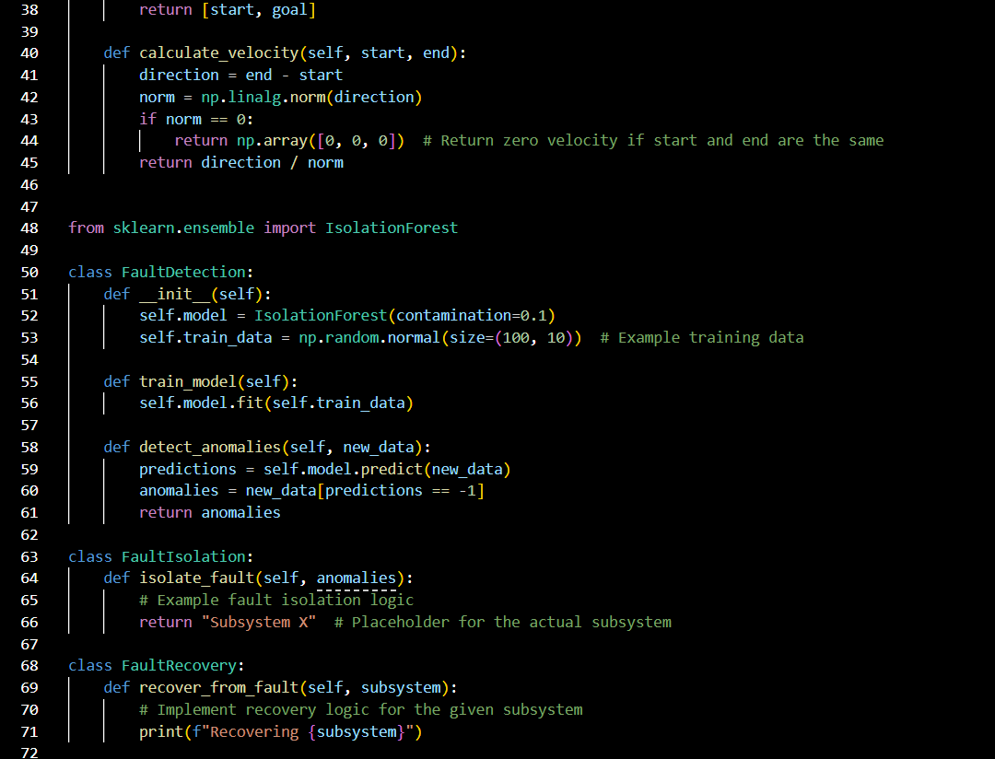
Implementation

Slide 15
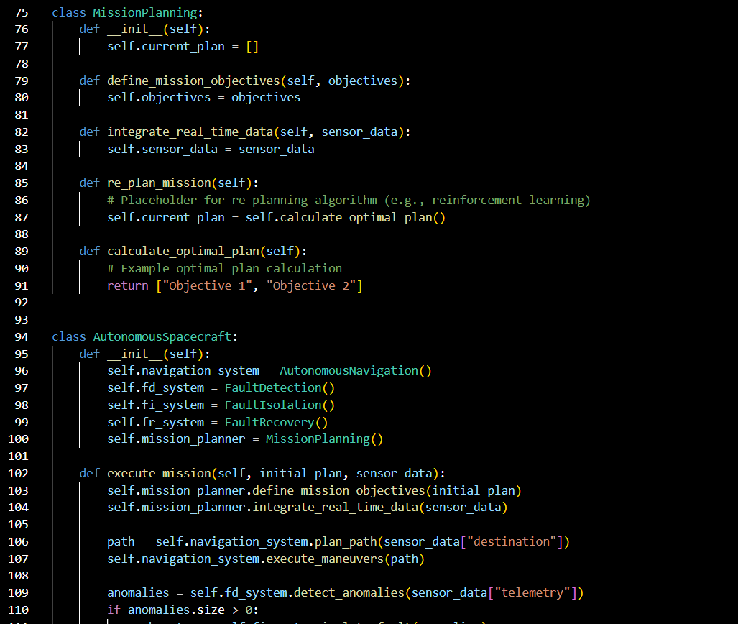
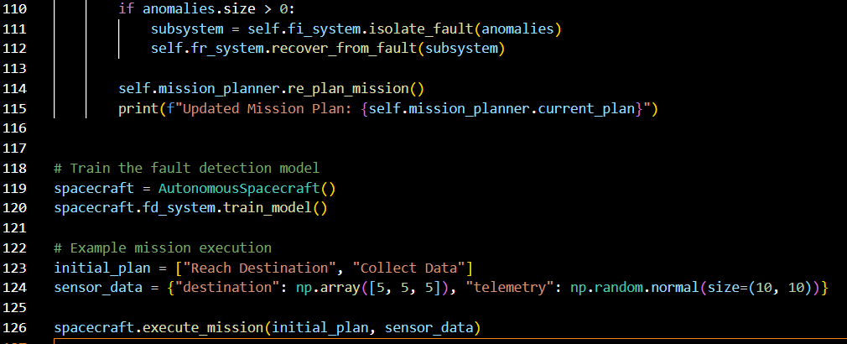

Slide 16
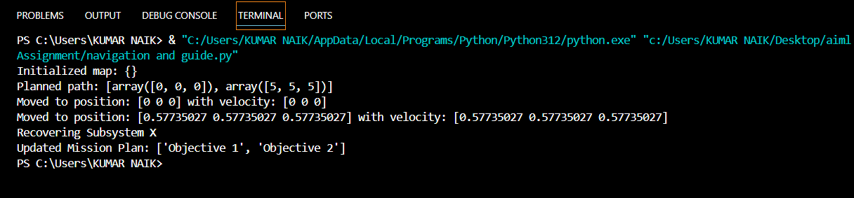
Results

Slide 17
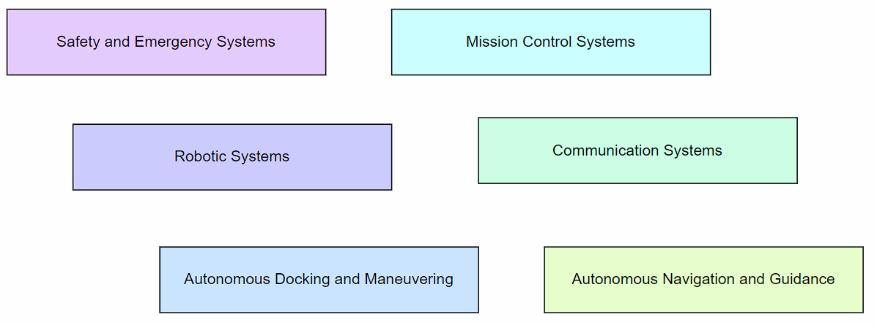
Applications

Slide 18
Conclusion
In conclusion, the integration of autonomous AI systems in spacecraft operations represents a significant leap forward in space exploration. These intelligent systems enhance mission efficiency, safety, and adaptability by performing critical tasks independently of human control. Key advancements such as autonomous navigation, fault detection and recovery, and onboard AI for mission planning have already begun to transform how we approach space missions.
As we continue to push the boundaries of space exploration, the role of AI will become increasingly pivotal. By reducing the dependency on ground control and enabling spacecraft to make autonomous decisions, we open up new possibilities for exploring distant celestial bodies and conducting ambitious missions beyond Earth's orbit.

Slide 19
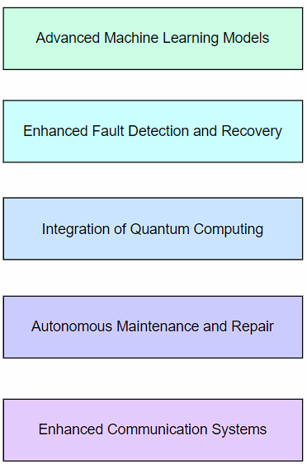
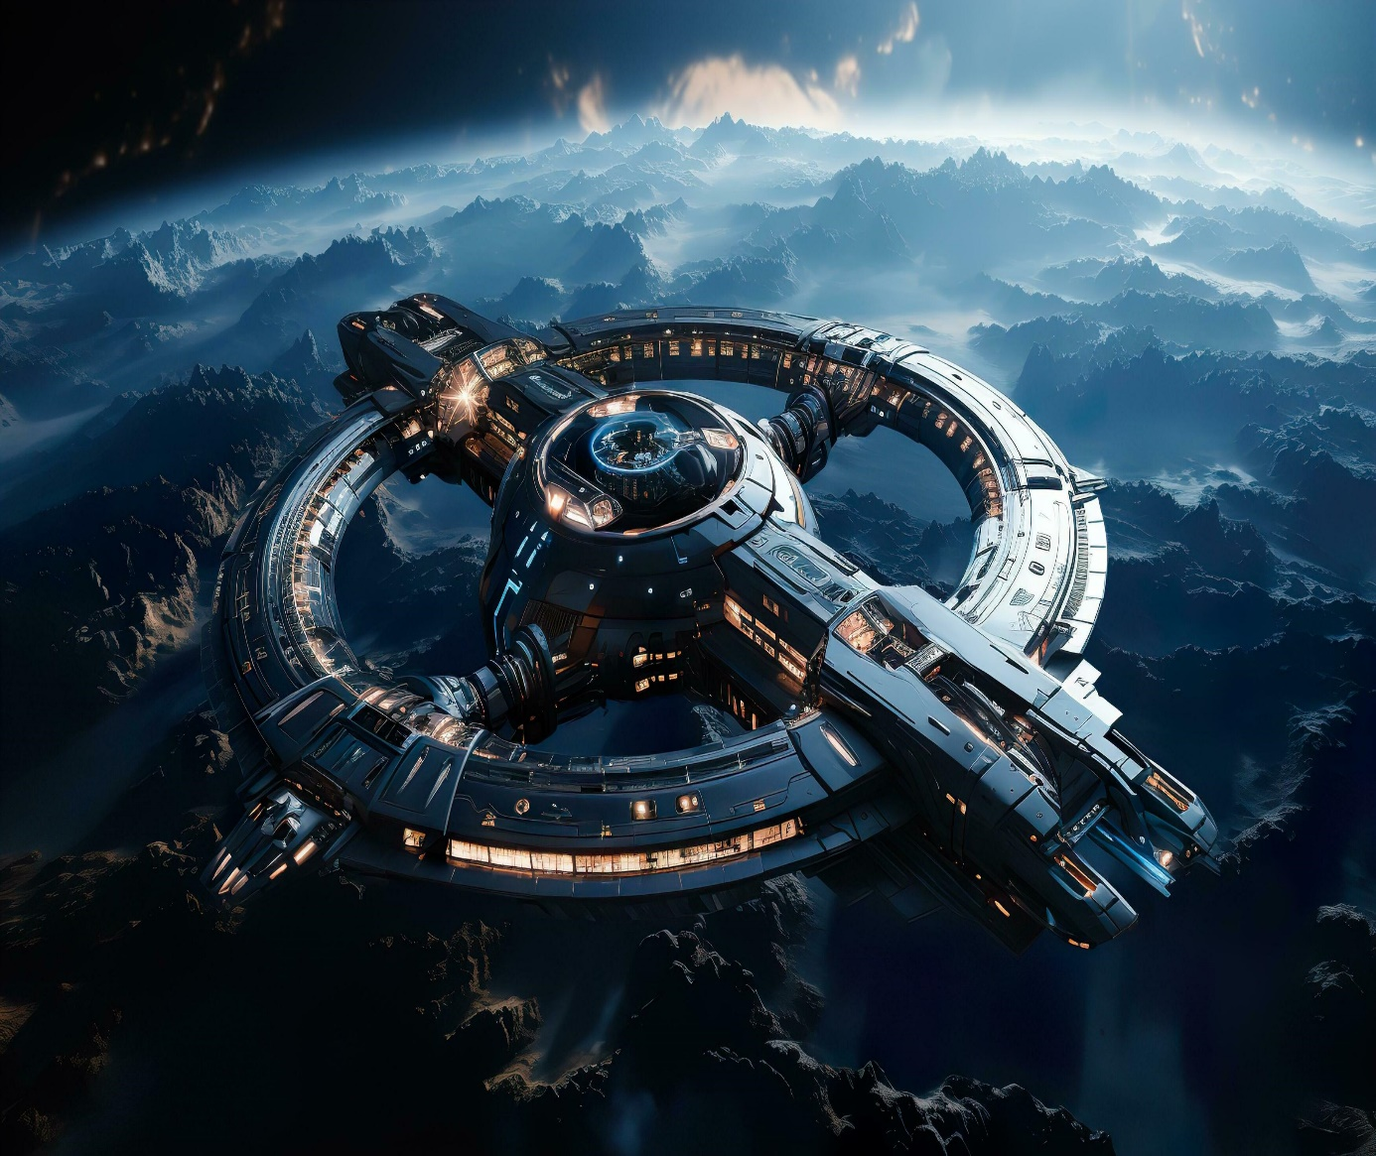
Future Enhancements

Slide 20
References
[1]. https://www.slideshare.net/slideshow/autonomous-spacecraft-navigation-with-artificial-intelligencepdf/266833564#20
[2]. https://www.geeksforgeeks.org/7-amazing-applications-of-ai-in-space-exploration/
[3].https://www.esa.int/Applications/Technology_Transfer/AIKO_Autonomous_satellite_operations_thanks_to_Artificial_Intelligence
[4]. https://www.geospatialworld.net/prime/prime-opinion/the-impact-of-artificial-intelligence-on-space-investment/
[5]. https://app.diagrams.net/
[6].https://www.esa.int/Space_Safety/Hera/Fault_detection_isolation_and_recovery
[7]. https://www.smithsonianmag.com/air-space-magazine/down-earth-180970809/

Slide 21
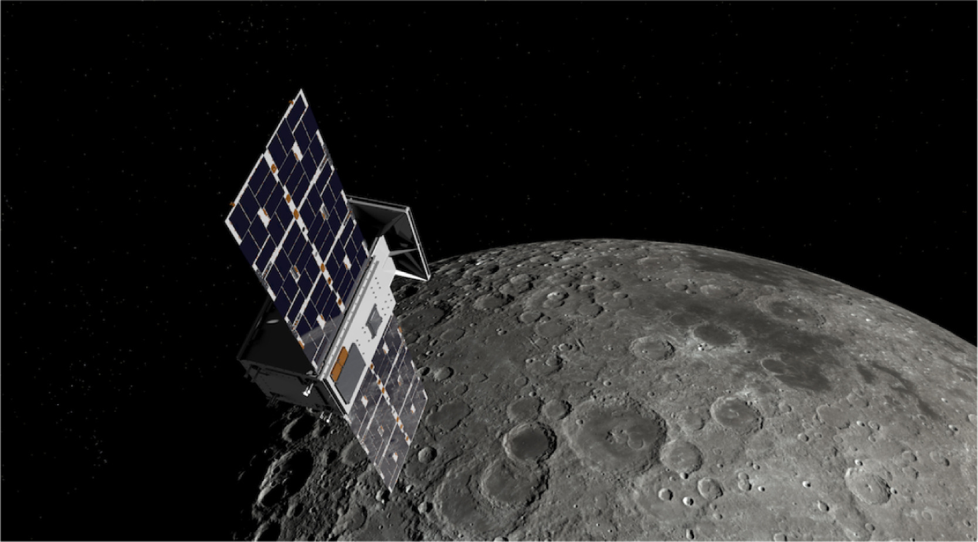
Thank You!

